Slide 1

Path-Way-Services
Group: 04
CSE 3224

Slide 2

Group Members:
Ullash Bhattacharjee 180104103
Mostafizur Rahman 180104112
Kaho Fardin Hasib 170204063
Presenter :
Mostafizur Rahman 180104112

Slide 3
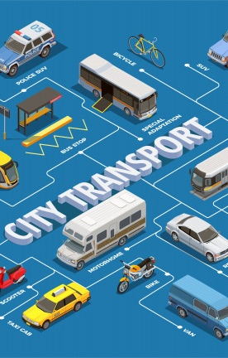
Introduction:
The name of our project is PATH-WAY SERVICES. It is basically a website that will help people to purchase tickets of transports. Bus, Train and Launches are the most commonly used public transports. But for now, we develop this website for the bus transport. People can easily book their tickets according to the date and available route.

Slide 4

Objective:
This project goal is to minimize the sufferings of purchasing tickets. Admin will keep the website updated with transport’s information, adding new routes, adding seat information handle pending tickets and so on. And for the users they can easily buy tickets, cancel booking, contact with the admin and so on.

Slide 5

Entity Names, Attributes and Data Types:
1.User:
User_Id [DataType: int]
User_Name [DataType: varchar]
Name [DataType: varchar]
User_Password [DataType: varchar]
User_Phn [DataType: varchar]

Slide 6
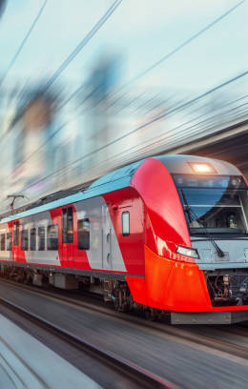
Entity Names, Attributes and Data Types:
2.Admin:
Admin_Id [DataType: int]
Adminuser_Name [DataType: varchar]
Password [DataType: varchar]
3.Route:
Route_Id [DataType: int]
Route_Name [DataType: varchar]

Slide 7
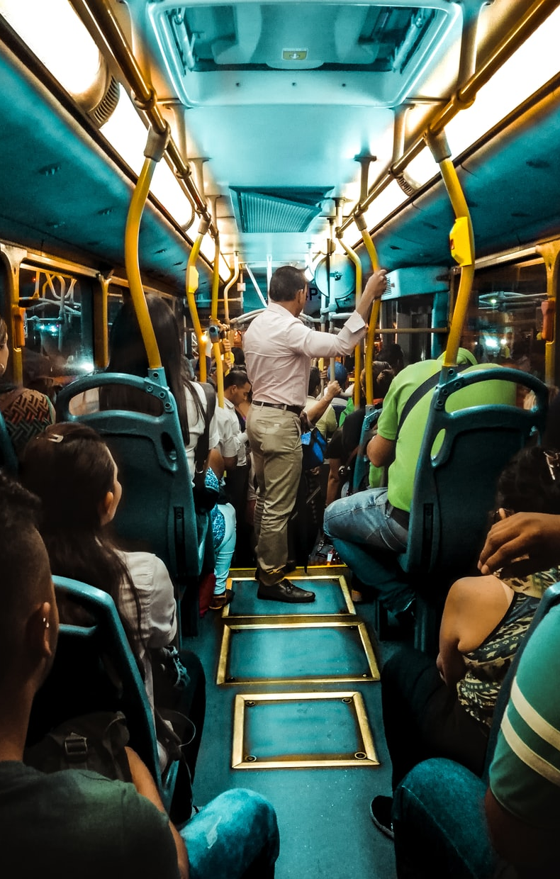
Entity Names, Attributes and Data Types:
4.Bus Schedule:
Bus_Id [DataType: int]
Route [DataType: varchar]
Total_Seat [DataType: int]
Seat_Cost [DataType: int]
Sold_Seat [DataType: int]
Available_Seat [DataType: int]
Date [DataType: varchar]
Time [DataType: varchar]

Slide 8
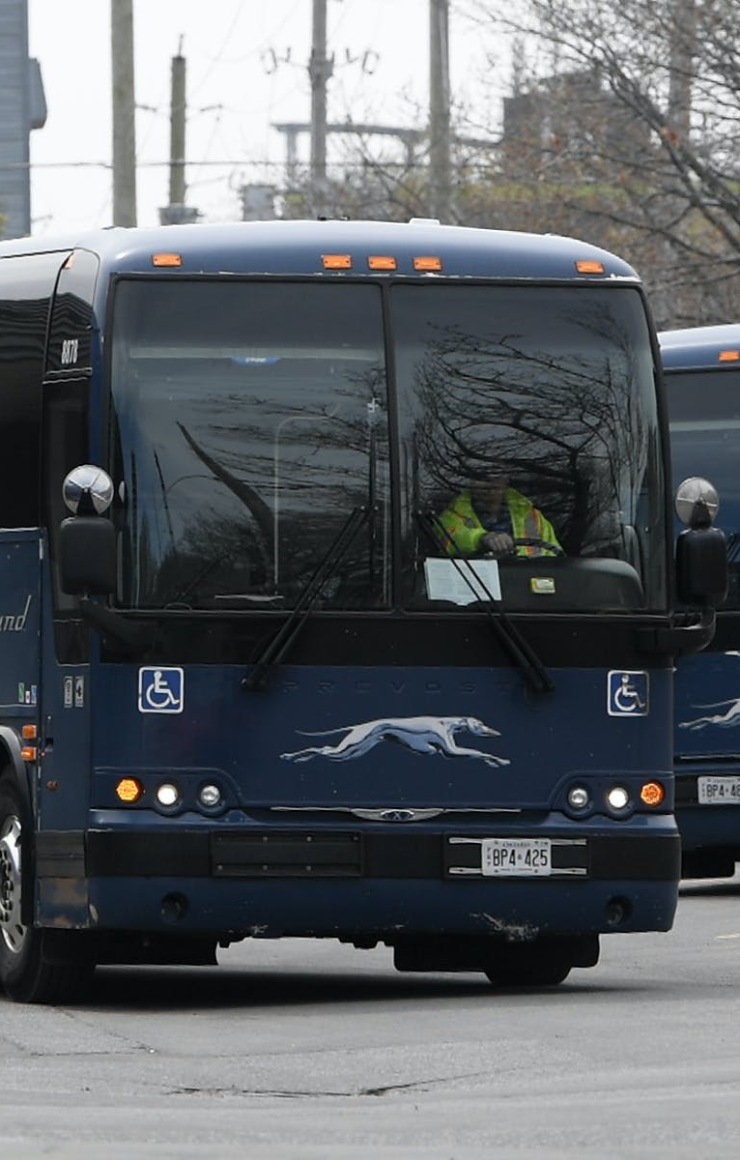
Entity Names, Attributes and Data Types:
5.Seat Information:
Seat_Id [DataType: int]
Bus_Id [DataType: int]
Seat_Name [DataType: varchar]
Sold_Seat [DataType: int]
Available_Seat [DataType: int]
Seat_Cost [DataType: int]

Slide 9
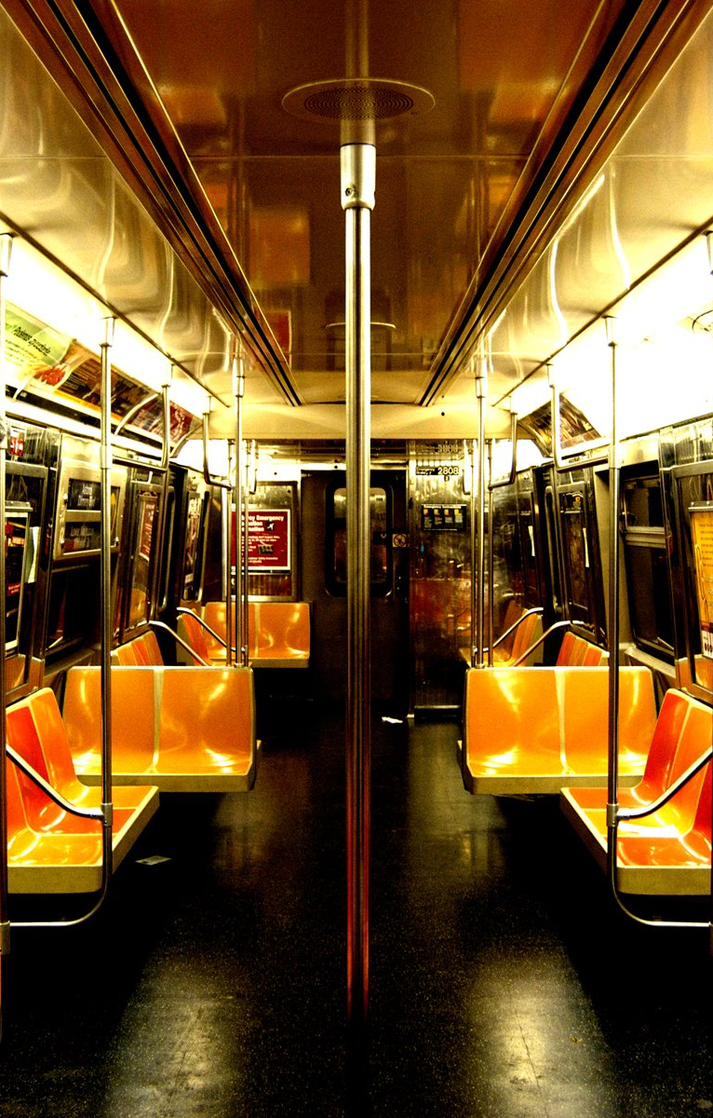
Entity Names, Attributes and Data Types:
6.Pending Tickets:
Pending_Id [DataType: int]
Bus_Id [DataType: int]
User_Name [DataType: varchar]
Full_Name [DataType: varchar]
Seat_Name [DataType: varchar]
Seat_Cost [DataType: int]
Transaction_No [DataType: varchar]
Status [DataType: varchar]

Slide 10

Entity Names, Attributes and Data Types:
7.Transaction Information:
ID [DataType: int]
User_Name [DataType: varchar]
Transaction_Date [DataType: varchar]
Transaction_Id [DataType: varchar]
Card_Type [DataType: varchar]
Amount [DataType: int]
Bank_Transaction_Id [DataType: varchar]
Status [DataType: varchar]

Slide 11

Entity Names, Attributes and Data Types:
8.Contact:
Contact_ID [DataType: int]
Full_Name [DataType: varchar]
Email [DataType: varchar]
Subject [DataType: varchar]
Message [DataType: varchar]

Slide 12

Relationship Between the Entity Sets:
1.Interact Through:
Between user/non-user and contact entities.
2.Reciving Message From:
Between admin and contact entities.

Slide 13
Relationship Between the Entity Sets:
3.Add:
Between admin and route entities.
Between admin and bus schedule entities.
Between admin and seat information entities.
4.Can See:
Between admin and pending tickets entities.
Between admin and transaction information entities.

Slide 14
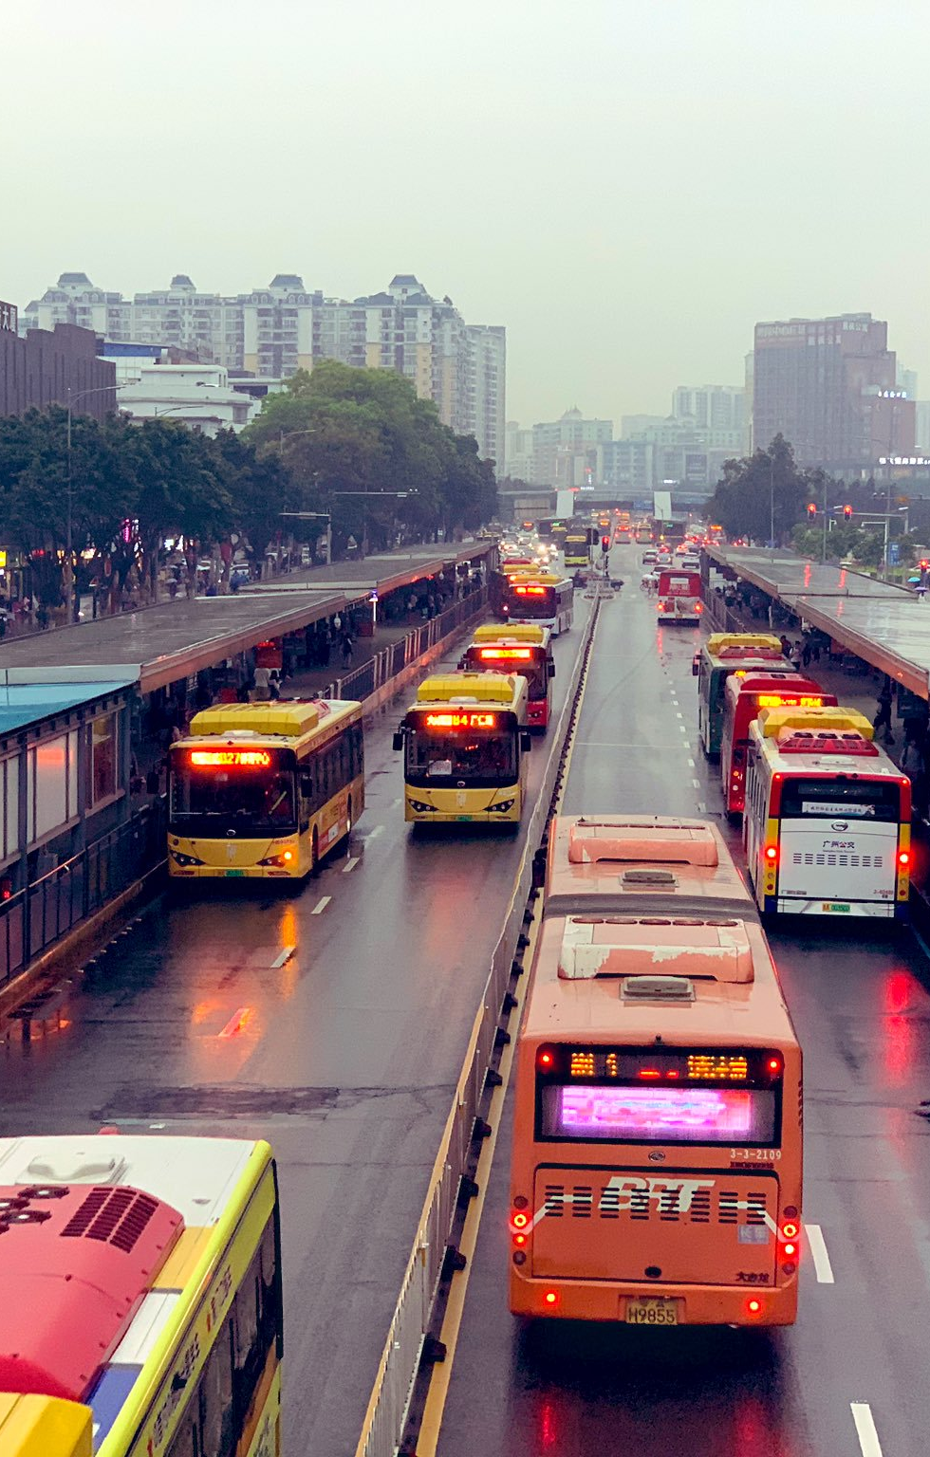
Relationship Between the Entity Sets:
5.Confirming Transaction Process:
Between user and transaction information entities.

Slide 15
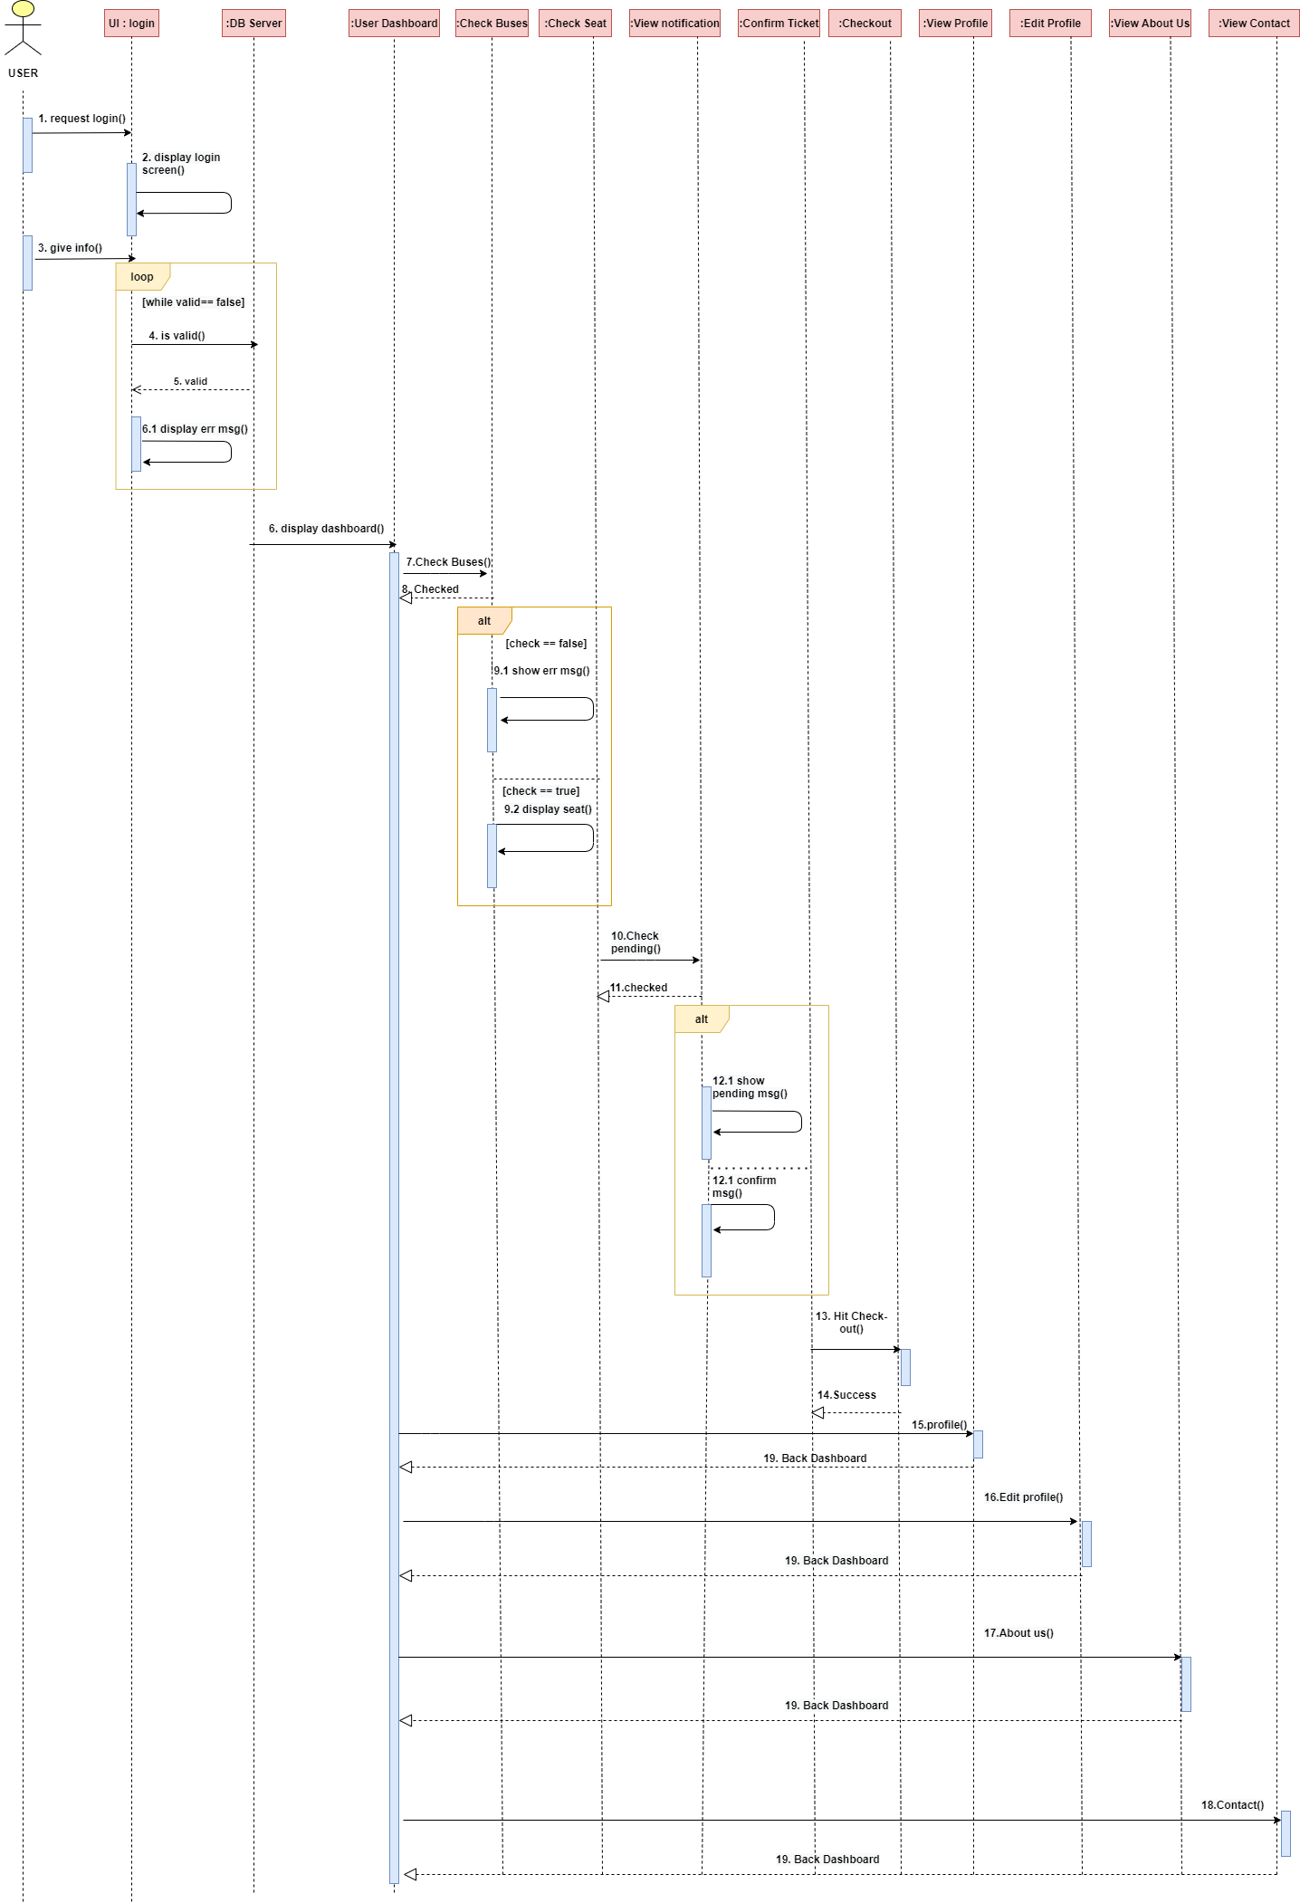
Sequence Diagram
Fig: User Sequence Diagram

Slide 16
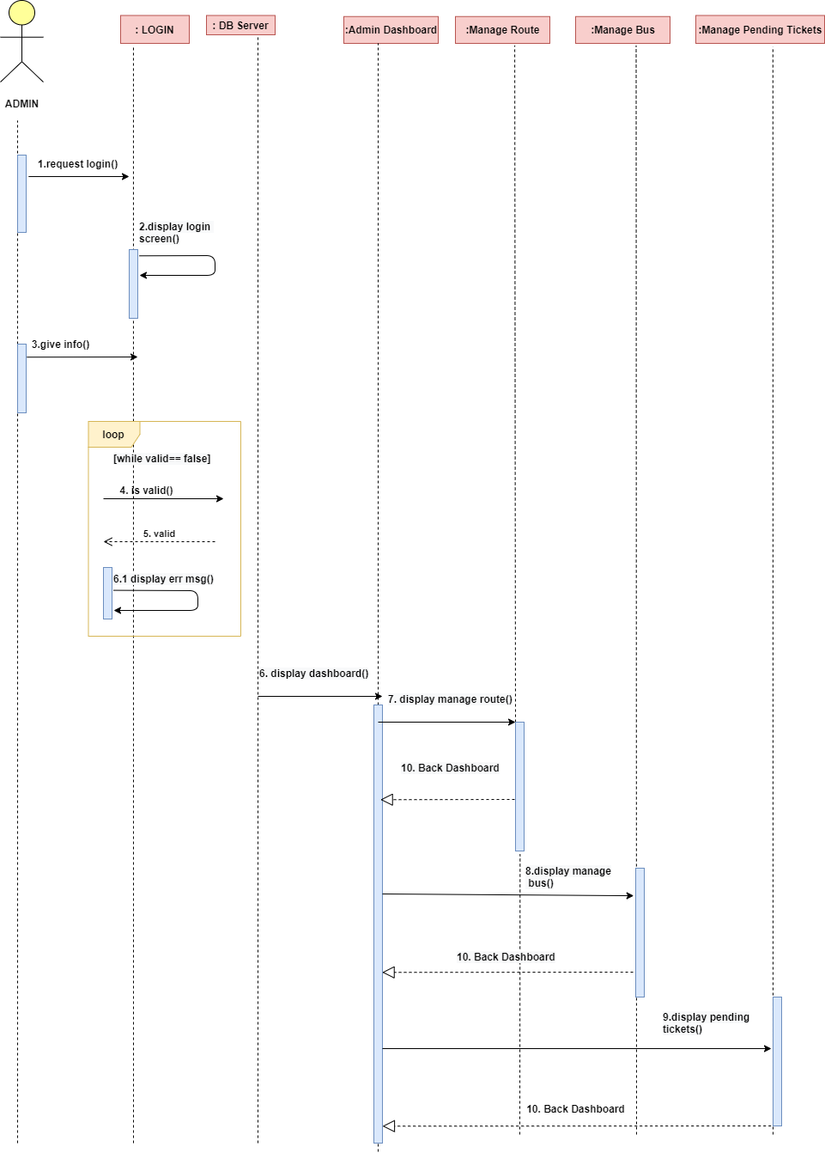
Fig: Admin Sequence Diagram

Slide 17
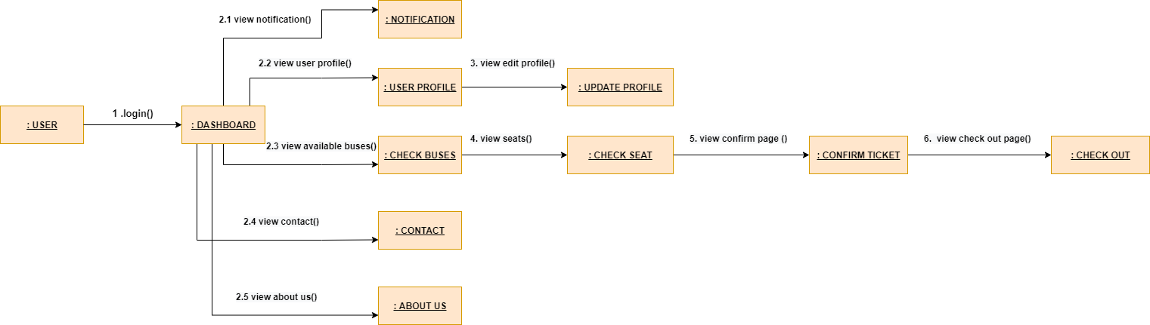
Collaboration Diagram
Fig: User Collaboration Diagram

Slide 18
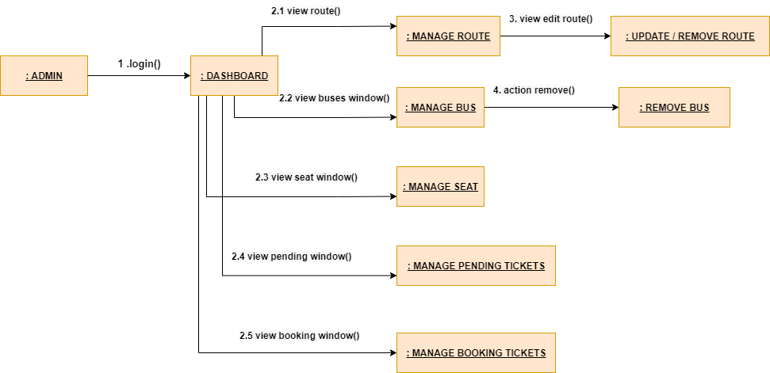
Collaboration Diagram
Fig: Admin Collaboration Diagram

Slide 19
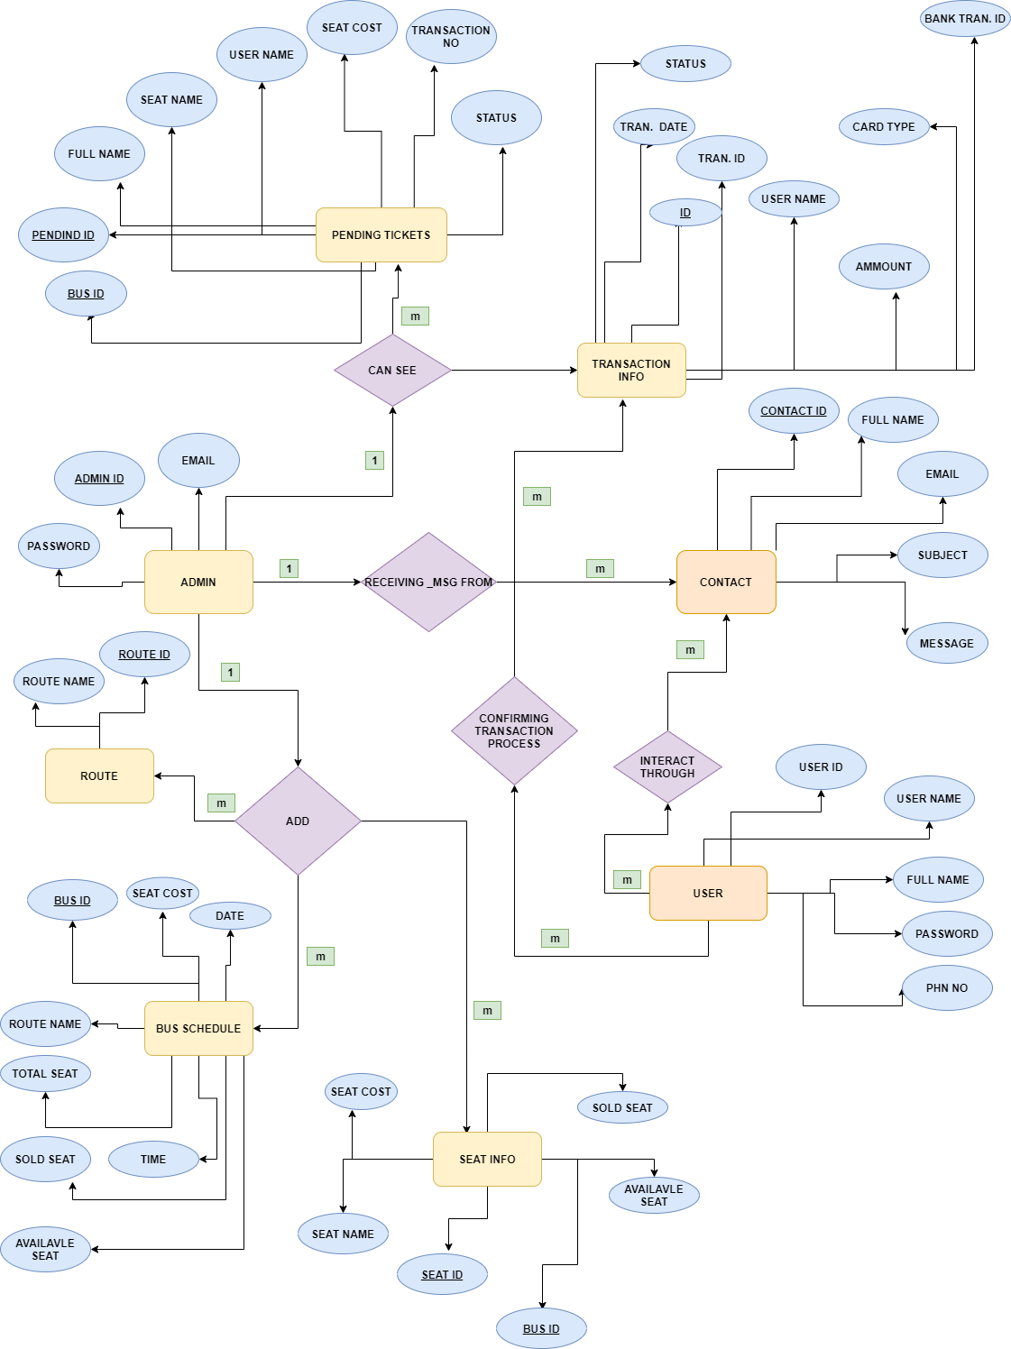
Entity Relationship Diagram
Fig: Admin Collaboration Diagram

Slide 20
Conclusion
It will be very helpful for the people in this pandemic situation. We hope this website will help the people to be more digitalized and will be successful in this platform. We will try keep this website updated with the modern world.

Slide 21
Thank you
someone@example.com

